Slide 1
Fractal Modeling
CS 418
Intro to Computer Graphics
John C. Hart

Slide 2
Fractal Dimension
s=1
s=1/2
s=1/3
D=0
Self-similarity dimension
Make a D dimensional object out of N smaller copies scaled by s
N = (1/s)^{D}
Can solve for dimension D
log N = D log 1/s
D = (log N)/(log 1/s)
N=1
N=1
N=1
D=1
N=1
N=2
N=3
D=2
N=1
N=4
N=9
D=3
N=1
N=8
N=27

Slide 3
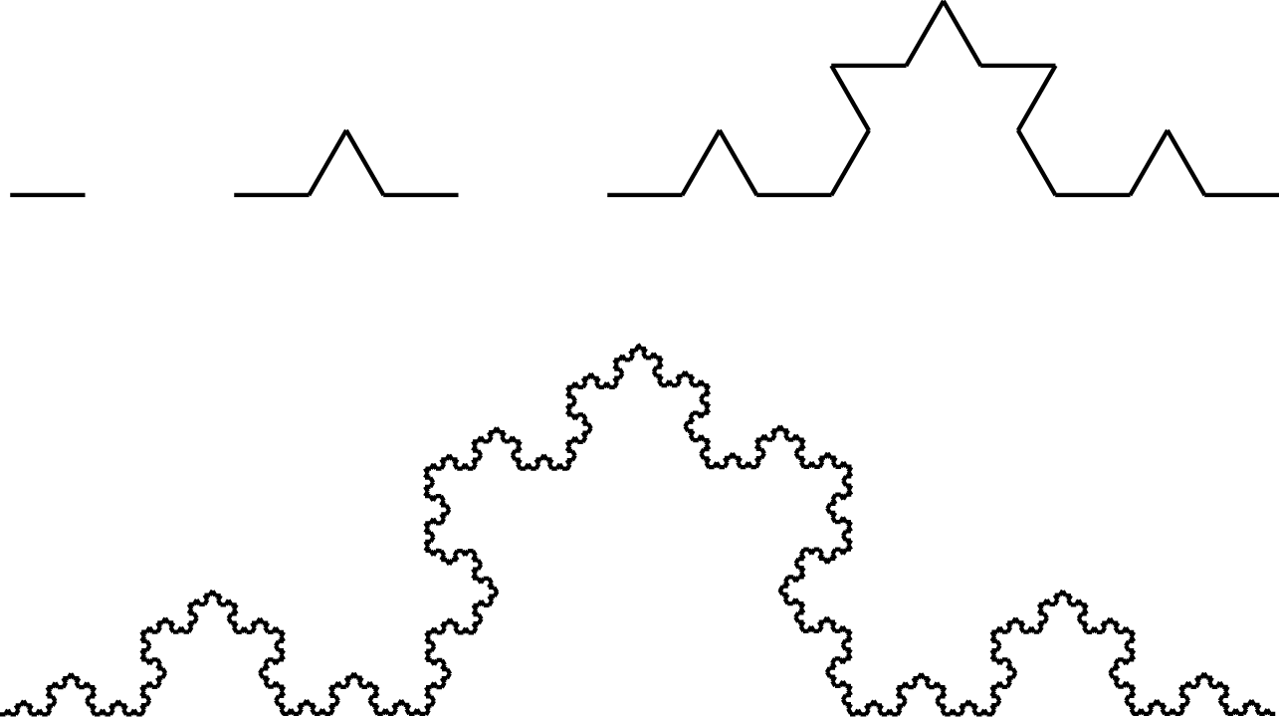
von Koch Snowflake Curve
Snowflake curve is made out of smaller copies of itself
  4 copies
  Each 1/3 scale
Dimension of snowflake curve
D = log 4/log 3 ≅ 1.26
Length = ∞
Area = 0
D = (log N)/(log 1/s)

Slide 4

Terrain Modeling
In nature, amplitude inversely proportional to frequency
“Large things are farther apart”
Nimbus,
Ken Musgrave,
1987

Slide 5

Midpoint Subdivision
Fournier, Fussell & Carpenter
To make terrain, subdivide a horizontal mesh and perturb the new vertices vertically
Amount of perturbation should be proportional to length of subdivided edge
Random perturbations should be Gaussian (more likely zero than extreme)
Can lead to some creasing artifacts
Carolina,
Ken Musgrave,
1989

Slide 6
Mesh Subdivision
Triangle subdivision
  three perturbed edge midpoints
  four new triangles
Quad subdivision
  four edge midpoints pluse one face midpoint
  four new quads
Cracking
  Use same perturbation on neighboring elements to avoid cracks
  Generate random displacement from hash function on midpoint location

Slide 7
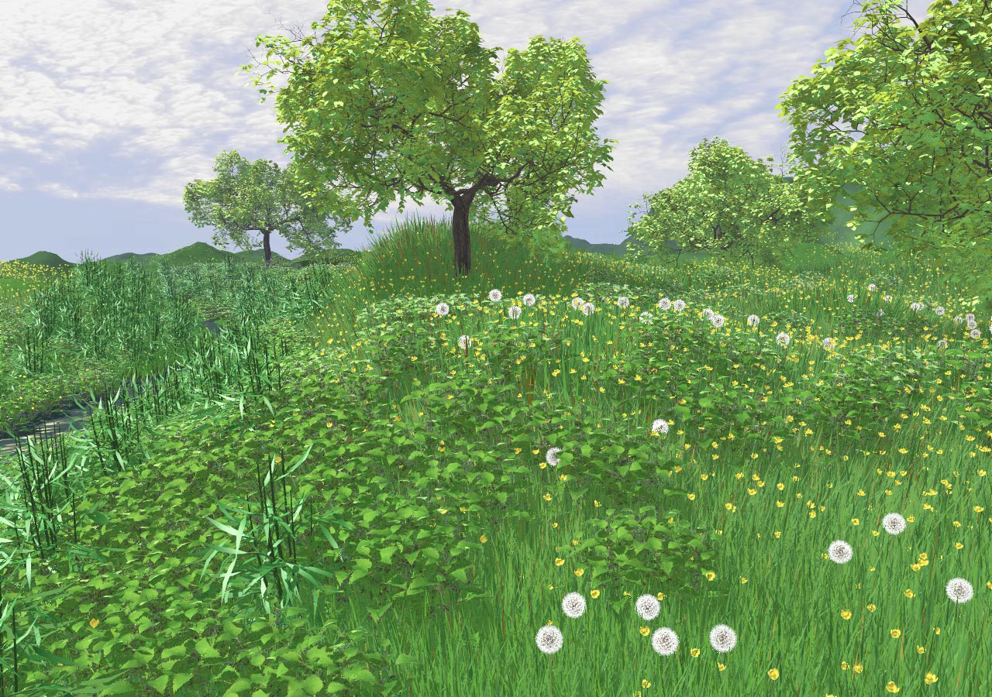

Botanical Modeling

Slide 8
Turtle Graphics
Correspondence between symbols and graphics commands
2-D turtle commands:
  F Draw forward one unit
  f Move forward one unit
  + Rotate turtle left
  – Rotate turtle right
Strings of symbols describe shapes
Units (F,f) and angles (+,-) are global constants
Turtle has state (like OpenGL state) consisting of position and orientation
Each commands changes turtle’s state

Slide 9
Turtle Graphics
  F Draw forward one unit
  f Move forward one unit
  + Rotate turtle left
  – Rotate turtle right
FFF+F+F-FFF-F+F+FFF+F+F-FFF-F+F+

Slide 10
L-System Grammar
Symbols: {F,+,–}
Productions:
{F → F+F--F+F}
Axioms: F
F
F+F--F+F
F+F--F+F +
F+F--F+F --
F+F--F+F +
F+F--F+F
Invented by Aristid Lindenmeyer
L-System components
  Set of symbols, e.g. {F,+,–}
    Terminal – output, e.g. {+,–}
    Non-terminal – replaced {F}
  Production(s), e.g. F→F+F--F+F
  Axiom(s), e.g. F
Parallel graph grammar
  Like a context free grammar
  But all non-terminal symbols are replaced simultaneously

Slide 11
von Koch Snowflake Curve
--
+,- = 60º
F+F--F+F
F+F--F+F
F
F+F--F+F
F+F--F+F +
+ F+F--F+F

Slide 12
Branching
Can use F,+,- to make a large number of squiggly lines
But want to model branching structures
Don’t want to have to retrace our steps whenever we branch
Turtle state stack
  “[” – pushes state onto stack
  “]” – pops state from stack
Use “[” to start a branch and “]” when finished to return to its base
F+F+F----f+F----f+…
vs.
F[+F[+F][-F]][-F[+F][-F]]

Slide 13
Branching Types
Monopodial
  Trunk extends undeviated to top
  Branches extend perpendicularly
Sympodial
  Trunk deviates to top
  Branches extend perpendicularly
Binary
  Trunk terminates at first branching point
  Branches deviate uniformly
Σ branch areas = base area (da Vinci)
T→T[+B][-B]T
T→T[---B]+T
T→T[+B][-B]

Slide 14
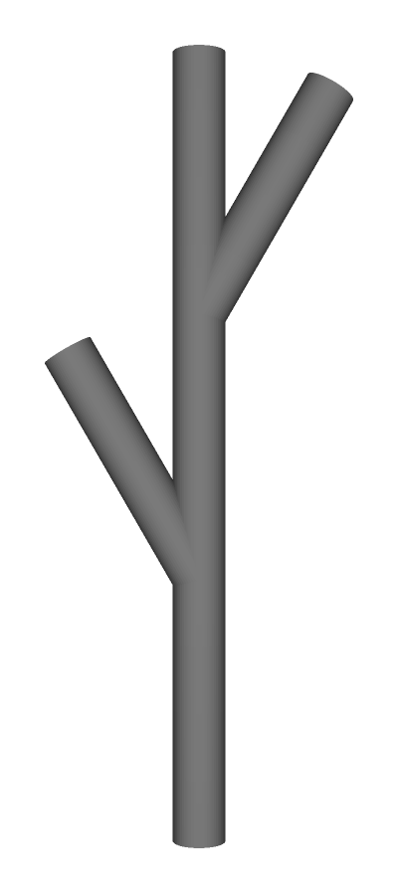
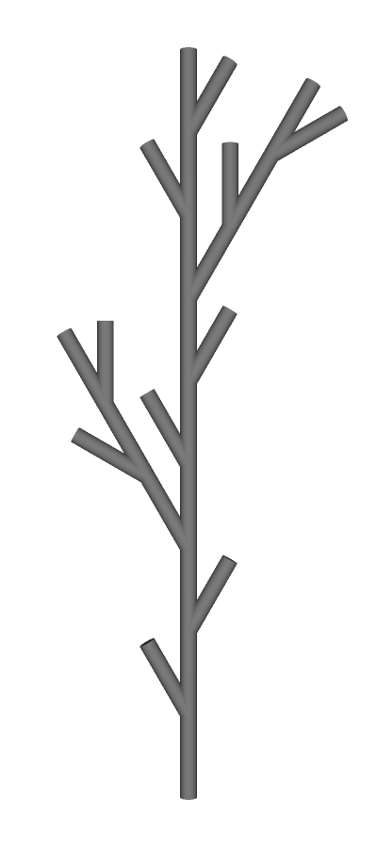

Bush
F→F[+F]F[-F]F

Slide 15
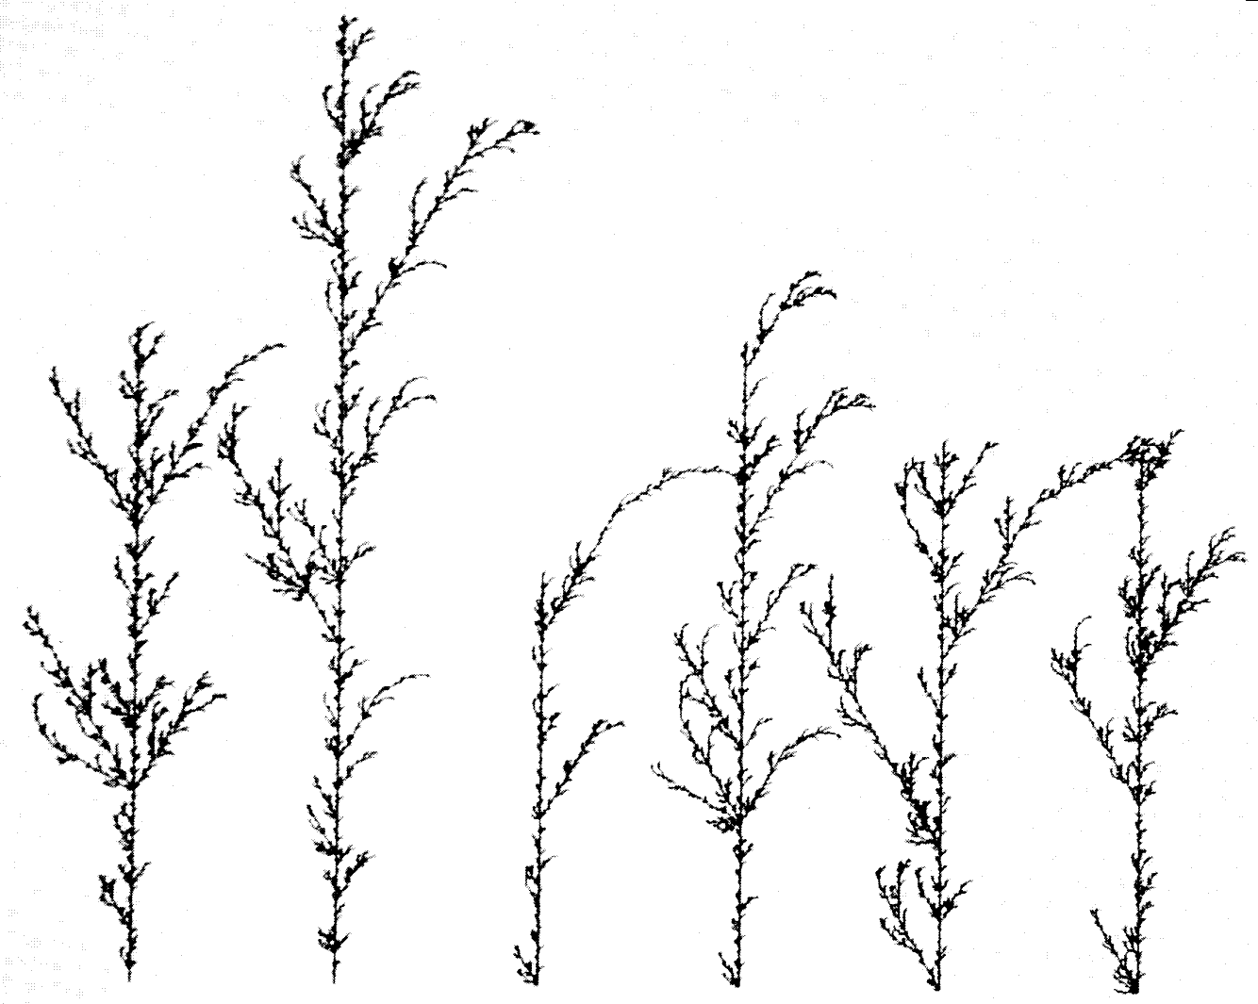
Stochastic L-Systems
Conditional firing of productions
NT → result : prob
Example: Random Bushes
F → F[+F]F[-F]F : .33
F → F[+F]F : .33
F → F[-F]F : .34
If not stochastic,
then deterministic

Slide 16
Parameterized 3-D Turtle Graphics
&
/
\
^
“+(θ )” – yaw left
“-(θ )” – yaw right
“^(θ )” – pitch up
“&(θ )” – pitch down
“\(θ )” – roll left
“/(θ )” – roll right
“F(x)” – draw x units
“f(x)” – move x units
U
L
H
-
+

Slide 17
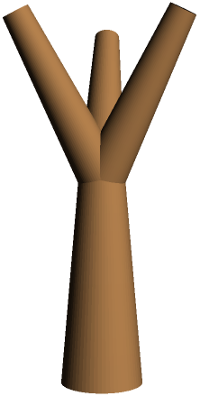
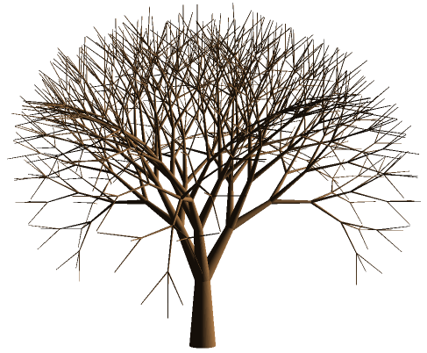
Ternary Tree
F → F[&F][&/F][&\F]

Slide 18
Other Turtle Commands
“!(w)” changes width of lines (cylinders)
  Decreases width if no parameter
“@O” draws a sphere
  Useful at branch joints
Generalized cylinder
  Delimited by “@Gs” and “@Ge”
  “@Gc” control point at current turtle position
Polygons
  Delimited by “{” and “}”
  Edge “F”, no edge “G”, vertex “.”
Bicubic Patches
  “@PS(n)” patch indexed by integer n
  “@PC(n,i,j)” current turtle position is (i,j)th control point of patch n
  “@PD(n)” draws patch n
Color & Texture
  “;” moved to next color table entry
  “;(f,b)” front color f, back color b
  “@T(n)” use texture n
“@L(string)” label at cur. pos.
“@S(cmd)” run OS command
Need the “@” symbol because turtle
quickly ran out of ASCII characters

Slide 19
Parameterized Productions
Non-terminals can be parameterized
Productions can be conditional
NT(param) : cond → result
Example: Long branches
B(n) : n > 0 → F B(n–1)
B(n) : n = 0 → F
Example: Fibonacci
A(n) : n > 1 → A(n-1)A(n-2)
A(n) : n = 1 → X
A(n) : n = 0 → ε (empty)
A(2) = A(1)A(0) = X
A(3) = A(2)A(1) = A(1)A(0)X
= XX
A(4) = A(3)A(2)
= A(2)A(1)A(1)A(0)
= A(1)A(0)XX
= XXX

Slide 20
Context Sensitivity
0L-System – context free
1L-System – one-sided context
L < NT → result
NT > R → result
  “<” and “>” part of syntax
  Only NT replaced, not L or R
2L-System – two-sided context
L < NT > R → result
Example: Signal Passing
B < A → B
B → A
BAAAAAAA
ABAAAAAA
AABAAAAA
AAABAAAA
AAAABAAA
AAAAABAA
AAAAAABA
AAAAAAAB
AAAAAAAA

Slide 21
Signals and Branches
Which way do the signals propagate?
Left context simulates acropetal propogation (base → leaves)
Right context simulates basipetal propogation (leaves → base)
IL-systems
  Ignore bracketed substrings when pattern matching for context
  Attempt all combinations of bracketed substrings
May need to completely ignore other symbols (e.g. +,-)
BC < S > G[H]M → X
ABC[DE][SG[HI[JK]L]MNO]

Slide 22
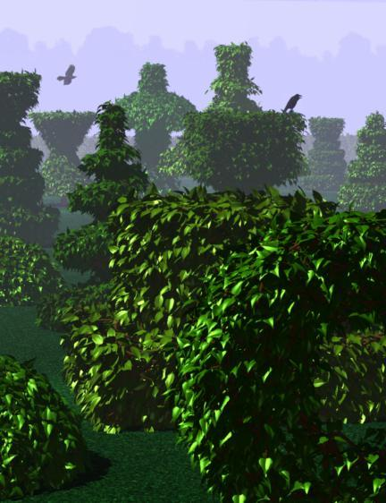
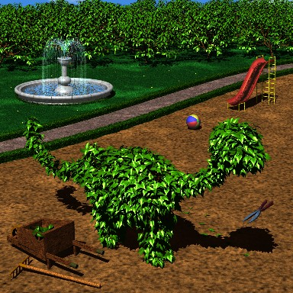
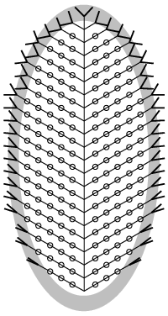
Topiary
Query symbol “?”
  “?P(x,y,z)” – position
  “?H(x,y,z)” – heading
  likewise turtle up and left vectors
Variables (x,y,z) replaced by actual values at current turtle position
Example: Ellipse
A → [+B][-B]F?P(x,y)A
B → F?P(x,y)@oB
?P(x,y) : 4x² + (y-10)² > 100 →
[+(2y)F][-(2y)F]%
“%” cuts all symbols to end of branch

Slide 23
Open L-Systems
Environmental query “?E(x₁,x₂,…)”
Queries the environment
Query at current turtle state
Example: Light sensitivity
  “?E(r)” how much light does a cluster of leaves of radius r at the current turtle position get?

Slide 24
Iterated Function System
An IFS is a set of N contractive affine transformations {w_{i}}
Example: Three tranformations that scale by ½ and translate halfway to the vertices of an equilateral triangle
Hutchinson operator
w(X) = ∪w_{i}(X)
Hutchinson operator applies the IFS to a shape to generate a new shape

Slide 25
Attractor
The IFS describes a unique set called an attractor A
A is invariant
A = w(A)
A is attractive
A = lim_{n→∞} w^{on}(B)
for any B*
* non-empty, compact

Slide 27
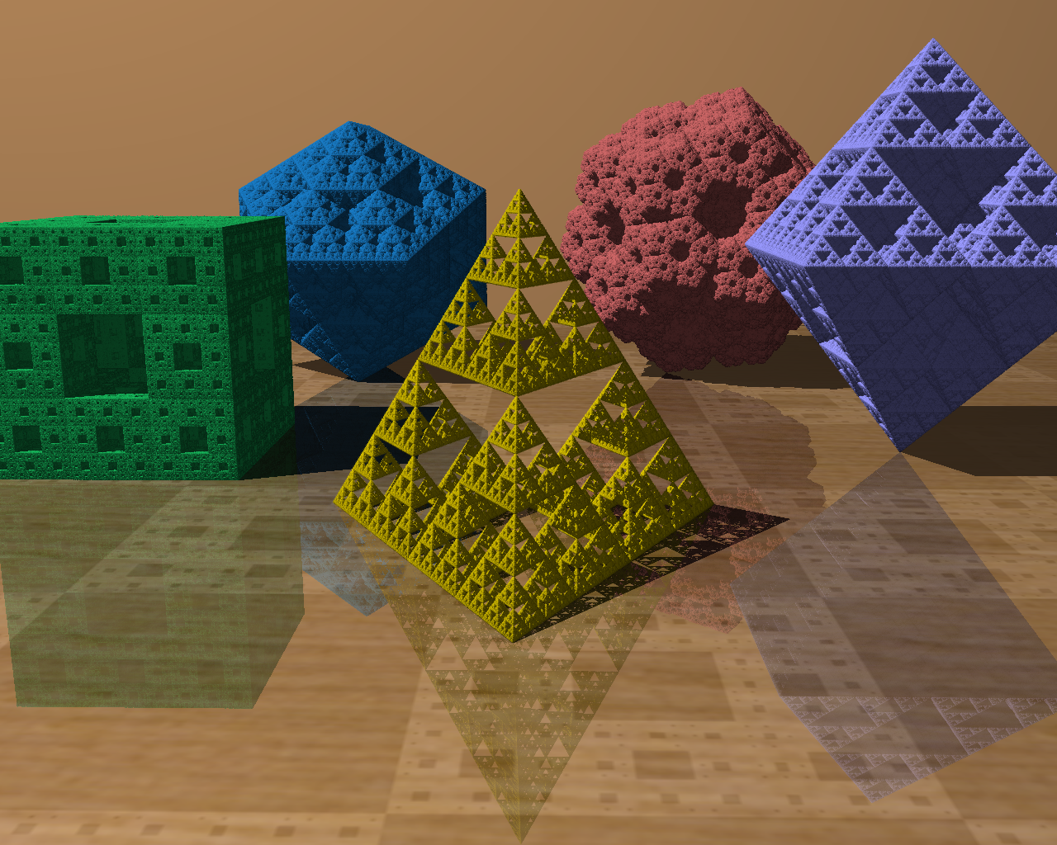

Slide 28
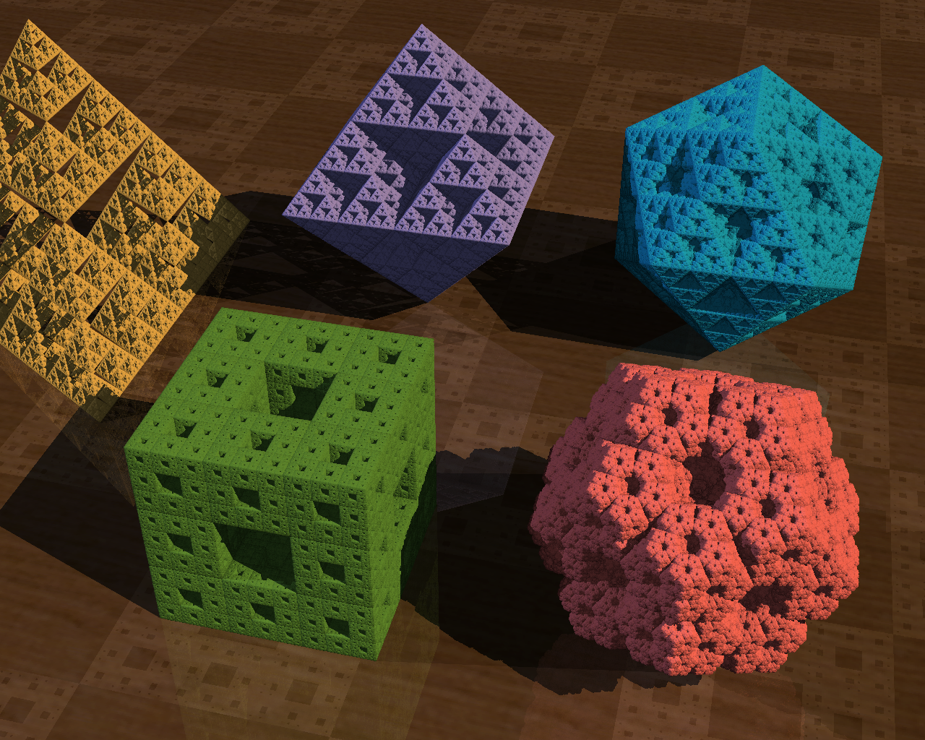

Slide 29
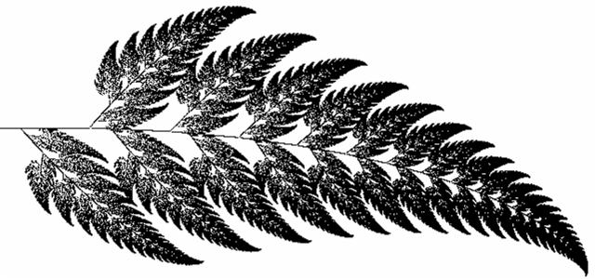
Designing Shapes
IFS models a shape out of smaller copies of itself
Attractorlets: A_{i} = w_{i}(A)
The transformations of the IFS take the shape to each of the smaller copies
Collage Theorem: A rough approximation B of an attractor A is only 1/(1 – Lip w) times worse than the approximation of w(B) by B

Slide 30
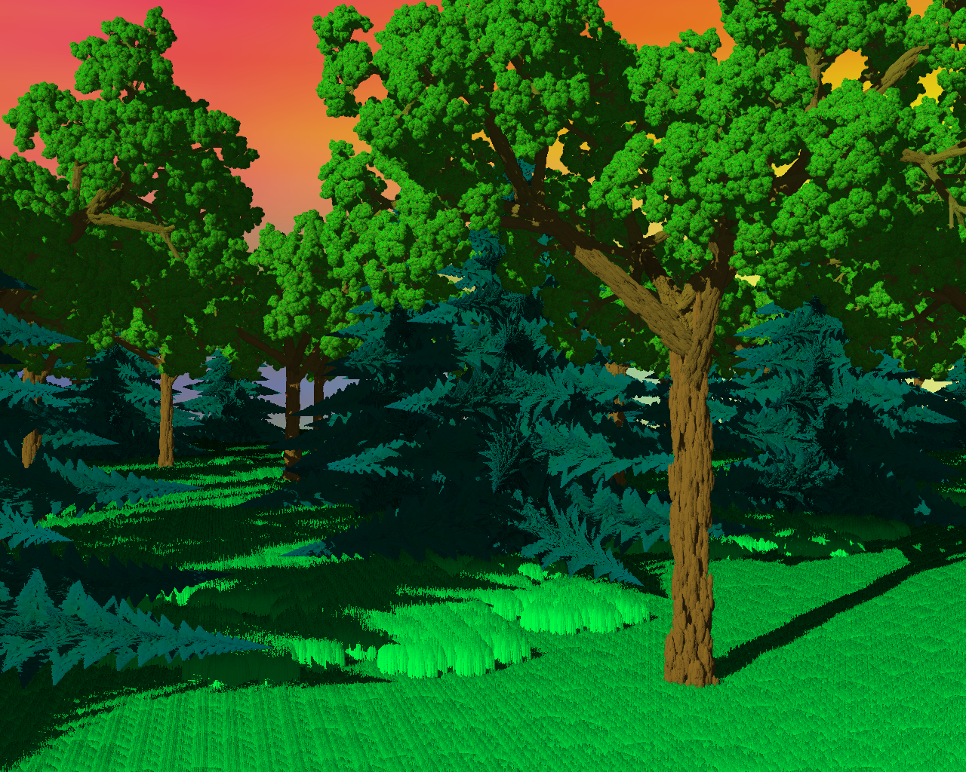

Slide 31
Chaos Game
Points off attractor
get closer
Points on attractor
stay on attractor
Iterating random IFS maps on a point on the attractor yields more points on the attractor
These points plot the attractor
Can start with any point
  Will converge quickly to points “on” (extremely near) the attractor
  Throw away the first 10 points
Distribution skewed
  Choose maps with probability inversely proportional to their contractivity
x = (0,0)
for (int i = 0; i < 10; i++)
x = w[N*rand ()]*x
while (1)
plot(x = w[N*rand ()]*x)

Slide 32
Bounding Volumes
If B is a bounding volume of an attractor A, then w(B) is a tighter bounding volume
But w(B) is also more complex

Slide 33
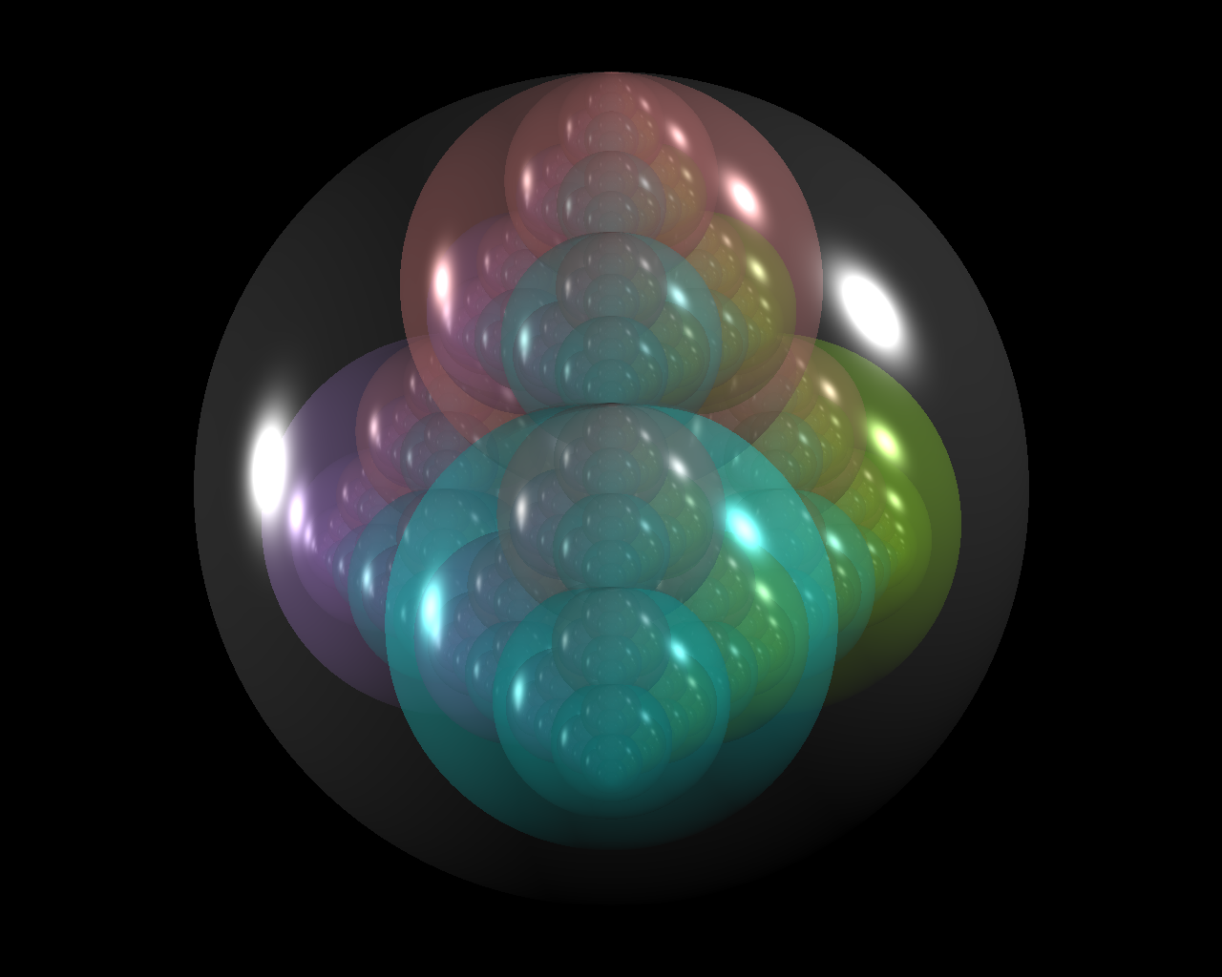

Slide 34
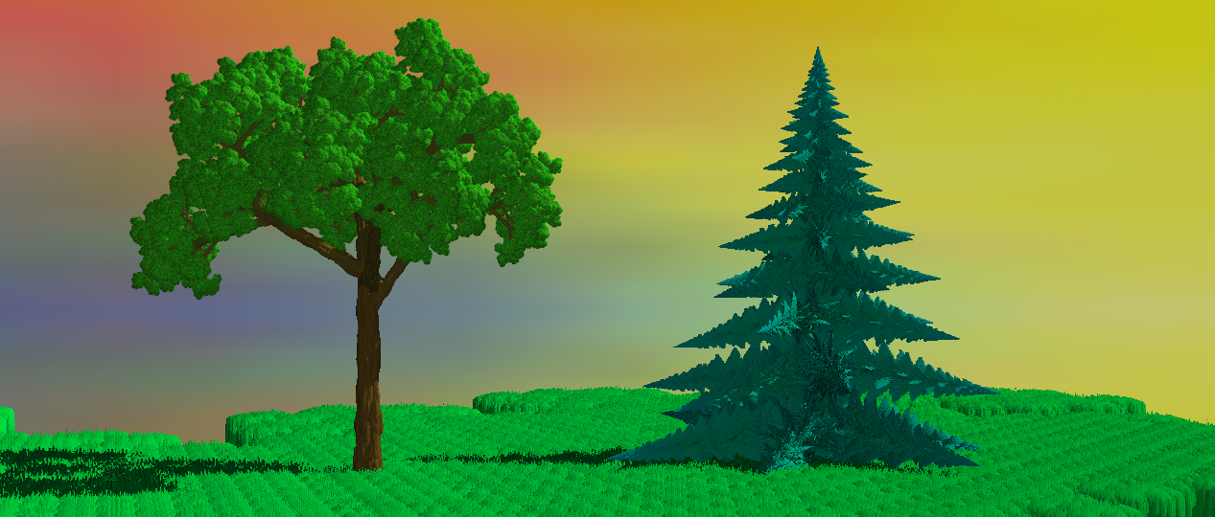


Slide 35
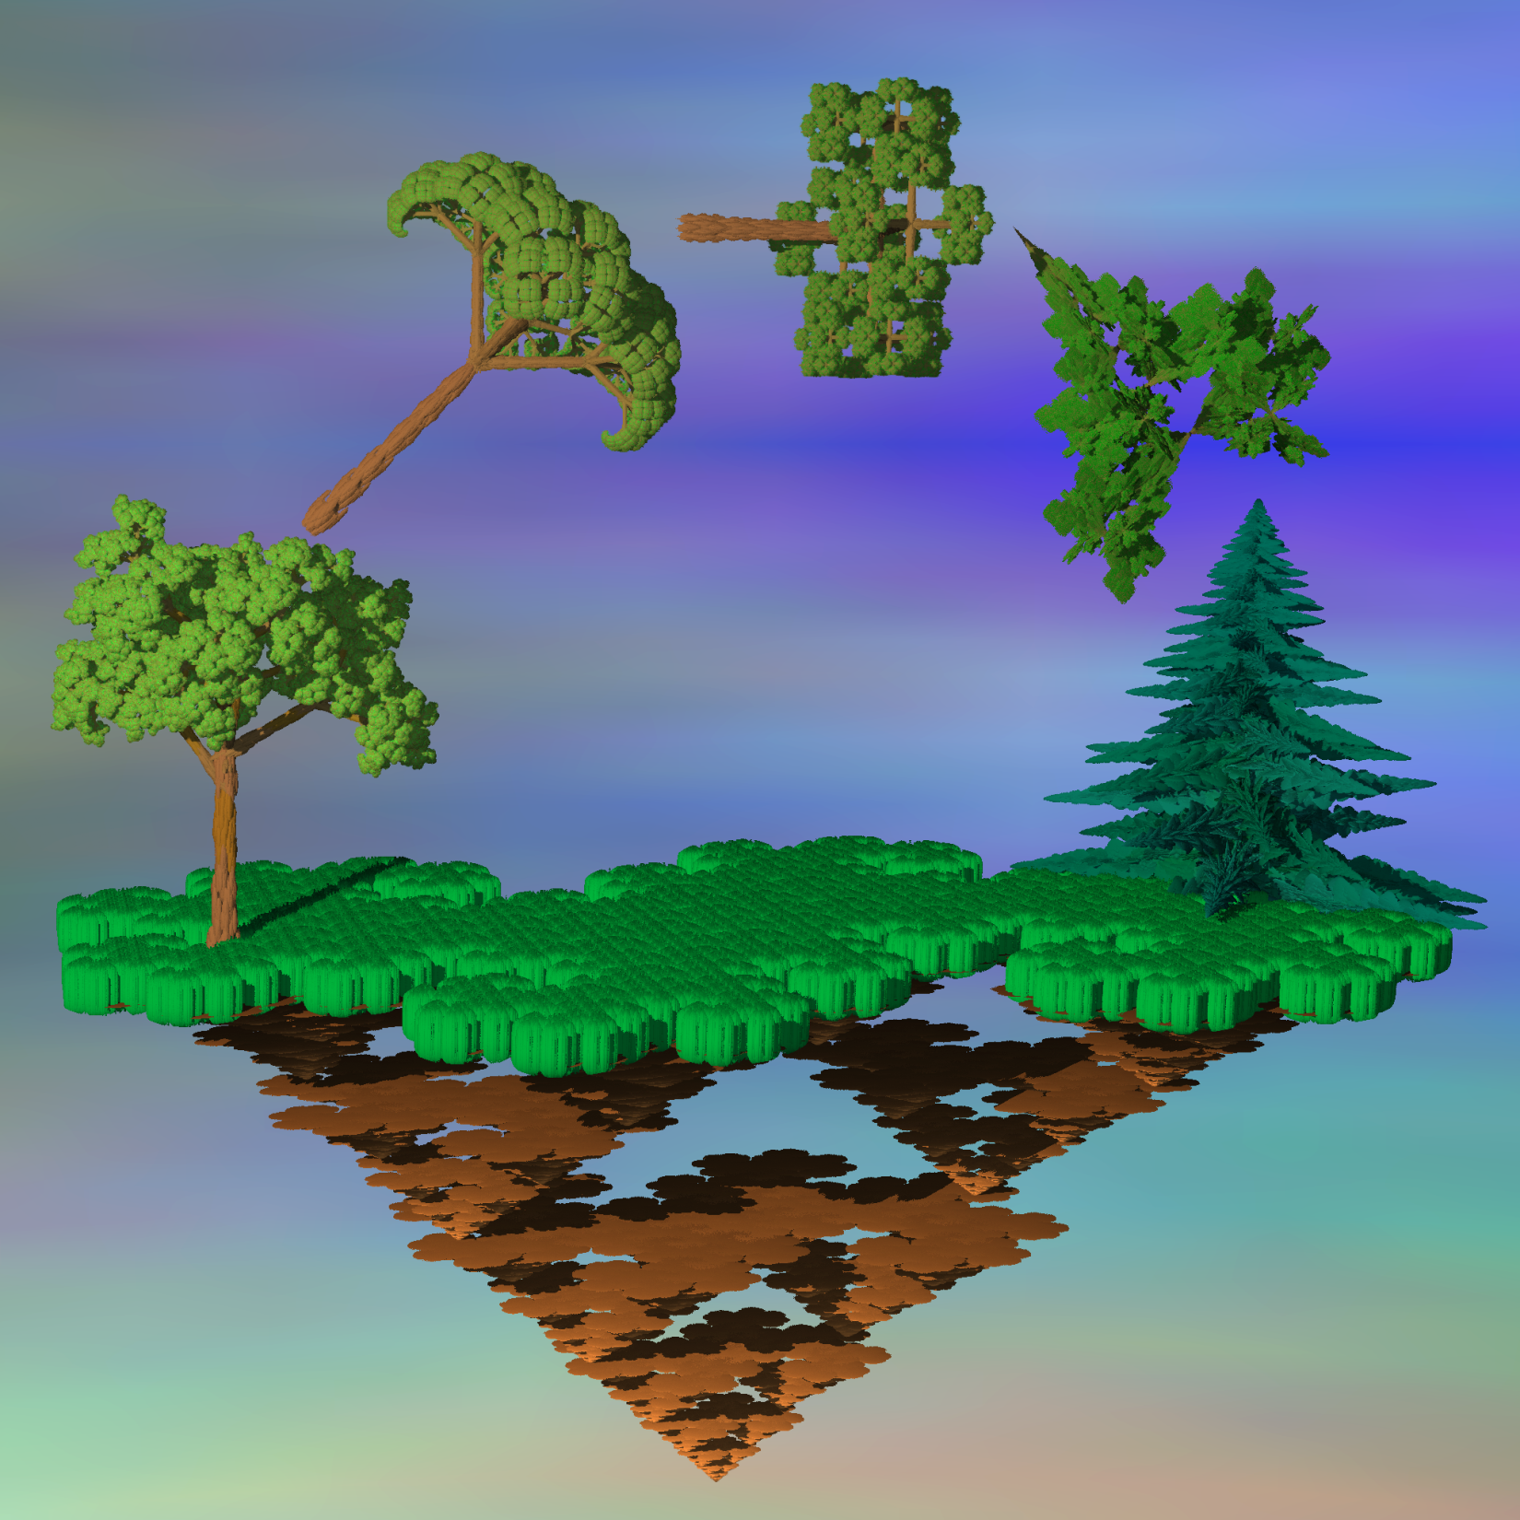

Slide 36
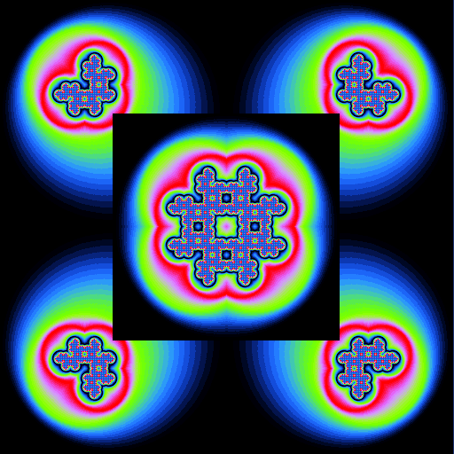
Recurrent Iterated Function Systems
RIFS contains a set of N contractive transformations as well an N vertex directed graph
Transformation w_{j} allowed to follow w_{i} if edge (i,j) in the graph
Recurrent Hutchinson operator
  Works on set-vectors (B₁,B₂,…,B_{N})
  If (C₁,C₂,…,C_{N}) = w(B₁,B₂,…,B_{N}) then C_{j} = ∪w_{j}(B_{i})
Attractor (A₁,A₂,…,A_{N})
  A = ∪A_{i}
  w(A₁,A₂,…,A_{N}) = (A₁,A₂,…,A_{N})

Slide 37
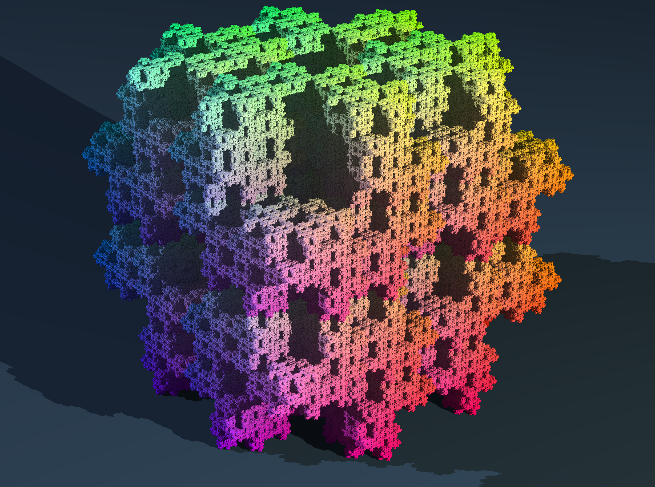

Slide 38
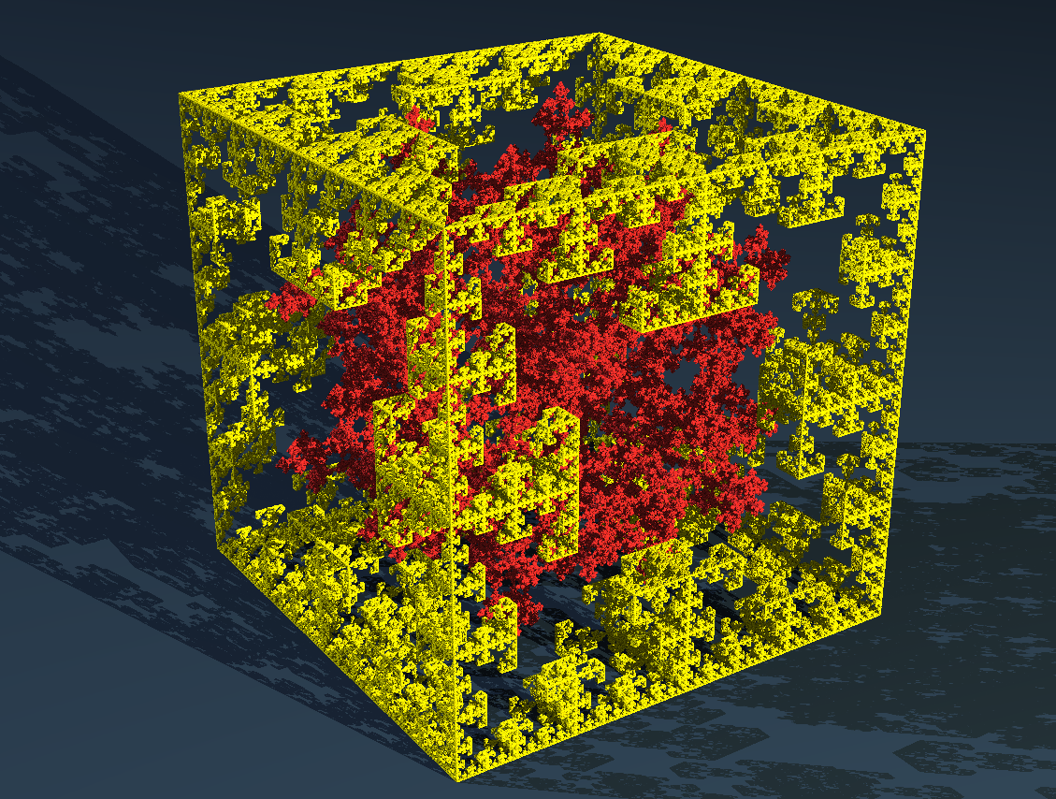

Slide 39
Kochski Gasket
Chaos game doesn’t work!
Need to keep a point in each of the attractorlets A_{i}

